Slide 1
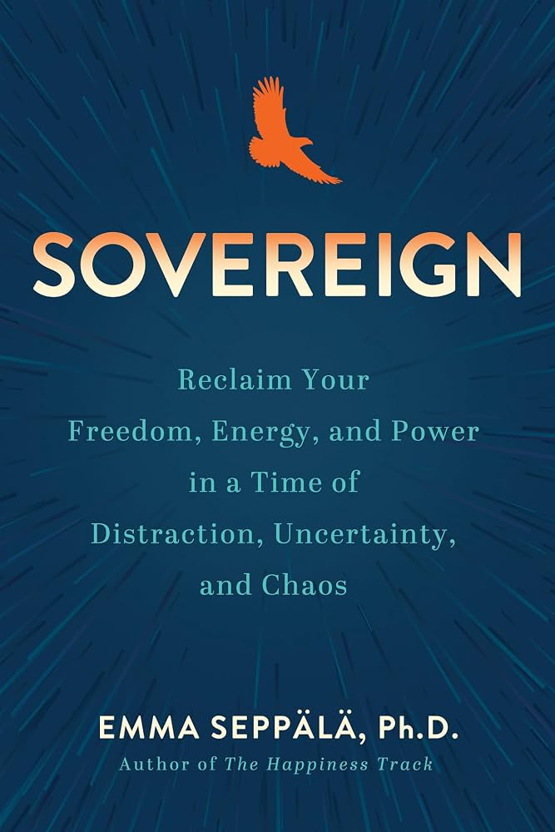
Sovereign
Book Highlights

Slide 2
The Bound Self and Self-Awareness
A bound self wears you down, depletes you and stops you from reaching your fullest potential
Self-criticism beats you up and keeps you in shame, which is just self-loathing
Self-awareness knows where you need help without guilt, shame or insecurity
You are good enough, in fact more than enough, exactly as you are

Slide 3
The Cost of Pretending
Pretending to be someone else drains energy, and it comes flooding back once you stop
Sovereignty is reclaiming your right to exist as you, from others and from yourself
Once you validate yourself, you stop hunting for approval outside
Shame strips your power and self-compassion is the antidote

Slide 4
Side Effects of a Sovereign Self
Awareness: you tune in to your needs and take care of them
Energy: you stop spending it on keeping up appearances and chasing approval
Boldness: you no longer fear being yourself or speaking your truth
Serenity: other people’s opinions stop weighing on you
Leadership: dancing to your own drum inspires others to do the same

Slide 5
Why Emotions Need our Attention
An emotion is action potential, a form of energy that has to go somewhere
Unprocessed anger or resentment can explode, or implode into physical symptoms
Technique number one is to feel the damn emotion
When you run from your feelings, you run from your healing

Slide 6
The Emotions Tool Kit
Breathe: slow exhales calm the heart rate, wake up the vagus nerve and bring back clear thinking
Be honest: emotions are contagious, like pollution or perfume, so choose which you spread
Express: writing about emotional difficulty, as Pennebaker showed, helps your mental health
Move and ground: exercise brings endorphins, a fresh outlook and relief from anxiety
Care for basics: rest, hydrate, nourish and go somewhere you feel at ease

Slide 7
Imprints and the Mirror of the Mind
Imprints come from life experience and from media, and emotional events stick the deepest
Should imprints are the cultural ones that keep us bound
Negative information weakens our ability to think, reason and perform
Nourish the mind with high quality imprints instead of endless scrolling

Slide 8
The Mind Tool Kit
Journal on where you feel most constricted and what you fear or crave most
Each night, replay your day backwards and set the intention to release harmful imprints
Breathing and meditation put you in charge of your own healing
Gratitude does not mean giving up ambition, it builds joy, optimism and resilience
Use social media for inspiration without losing your identity to it

Slide 9
Relationships as an Exchange of Energy
Care: see the best in people and let them feel seen, heard and valued
Support: offer kindness and compassion when others are struggling
Forgive: avoid blame and let go of grudges
Inspire: focus on what is going right and practice gratitude
Meaning and values: remember the impact of your work and treat people with respect, honesty and humility

Slide 10
The Three Types of Energizers
Crushers: charming and inspiring, but their imprint of not being enough makes them discard others
Sacrificers: generous and admired, but they do not know their limits and burn out
Stars: self-aware, humble, compassionate, forgiving and trustworthy
Stars have a healthy, supportive relationship with themselves and with others

Slide 11
Triggers and Boundaries
Blaming the other person leaves both of you drained and unhappy
Owning your part helps you grow and improves the relationship
Practice asserting your needs and asking for what you deserve
If you mess up a few times, the world moves on, and every crossed boundary is a chance to get stronger

Slide 12
Trusting Your Intuition
Sovereignty brings it all together: a kind self, calm emotions, a clear mind and healthy relationships
From that steady place, your inner voice becomes something you can actually trust
When a decision is complex and full of information, research suggests you are more likely to choose the right path.
By consulting your intuition and your feelings than by debating it with reason alone.

Slide 13
Disclaimer
This is just a summary. This summary is as per my interpretation and
Learning, Please excuse any errors.
For a better understanding, reading the book is highly recommended
Please excuse any errors.

Slide 14
Thank You For Reading
For more updates, follow
www.unleashtheyou.com

